Slide 1
Pitfalls and Risks of AI and Big Data
By Yaohang Li, Ph.D. Department of Computer Science Old Dominion University yaohang@cs.odu.edu

Slide 2
Agenda
Pitfall 1: Are patterns found by AI really meaningful?
Pitfall 2: More Data -> Better Model?
Pitfall 3: Are AI models Reliable?
Pitfall 4: Fighting Fake Contents

Slide 3
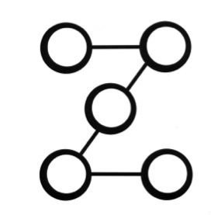

Pitfall 1: Are patterns found by AI really meaningful?
Patterns
Computational
Power
AI
Algorithms
Big Data
+
+
Are these patterns really meaningful?

Slide 4
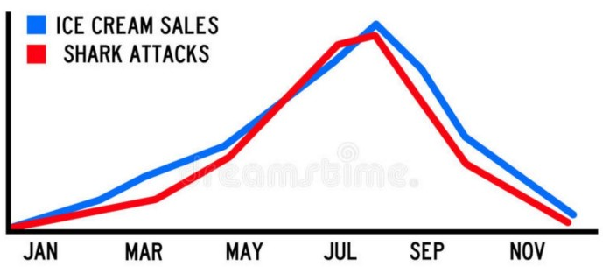
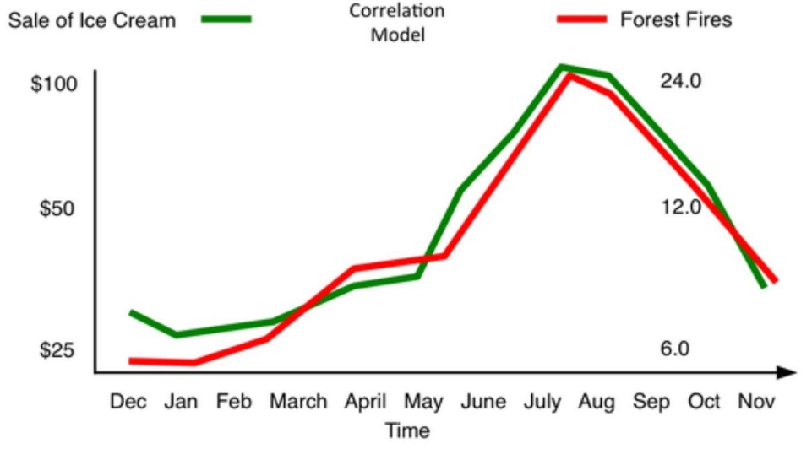
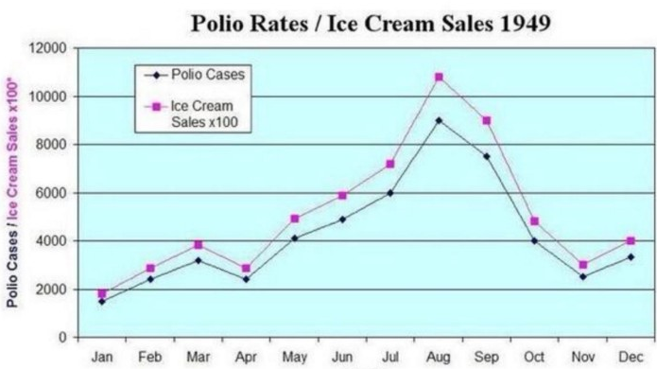
Correlation vs. Causation
Correlation does NOT imply causation
Even if two variables behave in the same way, we should not conclude that the behavior of one is the cause to the other
Ice Cream Should be Banned!
The hidden risk of AI and Big Data, by Vegard Flovik

Slide 5
Spurious Correlation
Spurious Correlation
Two or more events or variables
Associated
But not causally related
Due to
Coincidence
Existence of a third, unseen factor
Lurking variable (common response variable)
Lurking variable behind the Ice Cream example
Weather
Buy ice cream
Swim
Forest fire
Outbreak of Polio

Slide 6
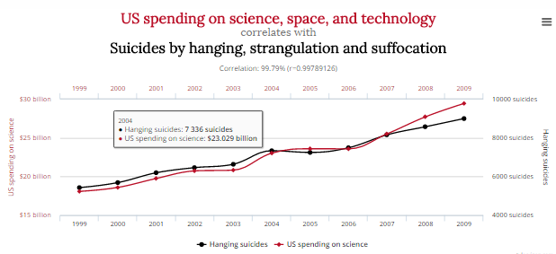
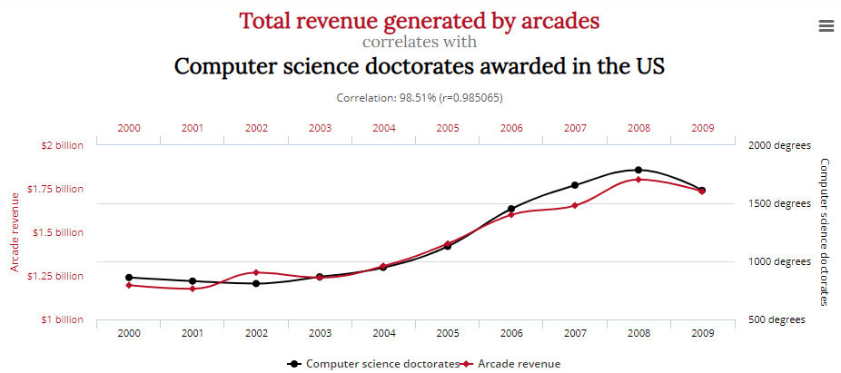
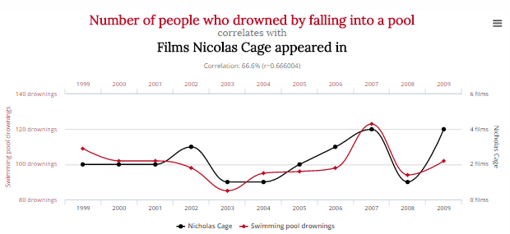
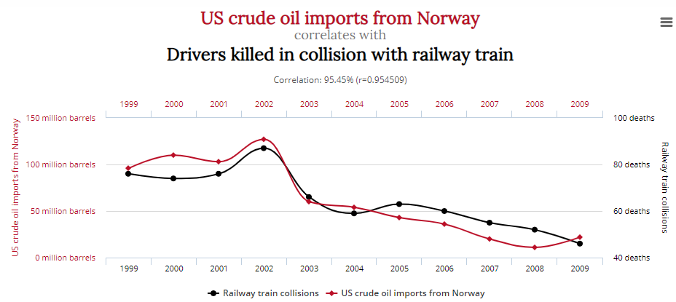
Other Examples of Spurious Correlations
http://tylervigen.com/spurious-correlations

Slide 7
Meaningfulness of Correlations
Big Data
Meaningful correlations
Indicating causations
Spurious correlations
More data, more likely to find spurious correlations
Spurious correlations can outnumber meaningful correlations
Challenge
Can AI spot when correlation DOES mean causation?
Scientific Methods
Can be enriched by big data
Cannot be replaced by big data analysis

Slide 8
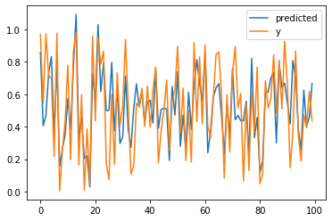
Demo: Spurious Correlation
Jupyter notbook spurious_correlation.ipynb

Slide 9
Pitfall 2: More Data -> Better Model?
Can more data gives better results?
Many cases: Yes
Some cases: No
Calude, C.S., Longo, G. The Deluge of Spurious Correlations in Big Data. Found Sci 22, 595–612 (2017).

Slide 10
More Data has Two Meanings
Wilder
More features for each sample
Deeper
More data samples

Slide 11
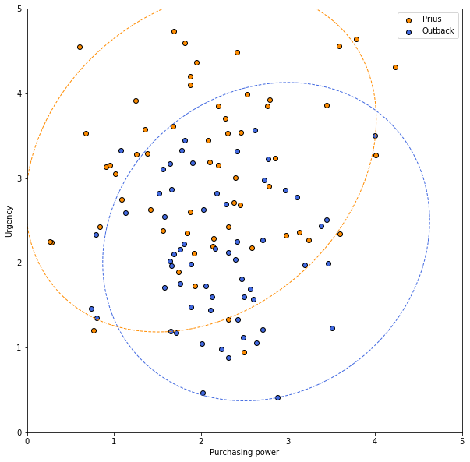
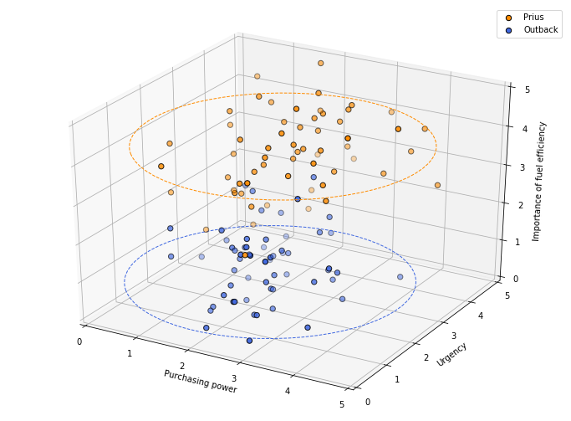
A Car Dealership Example
Predict a customer’s choice
Add more data (feature) on “fuel efficiency”
More Data isn’t Always Better
Despite the intuition most us have that more information can’t hurt, it actually can – Aaron Lipeles

Slide 12
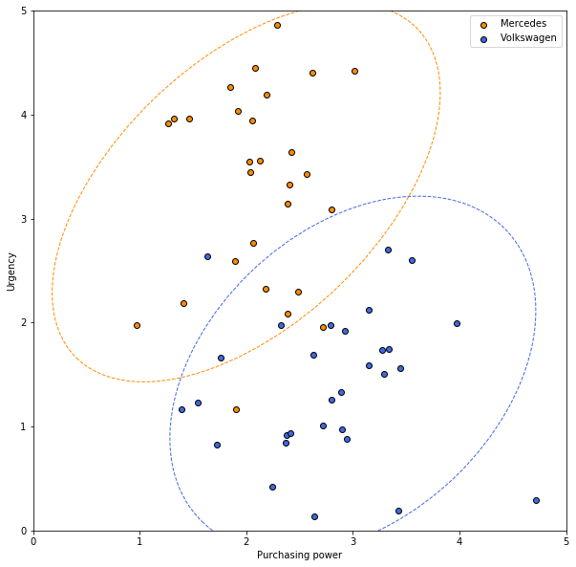
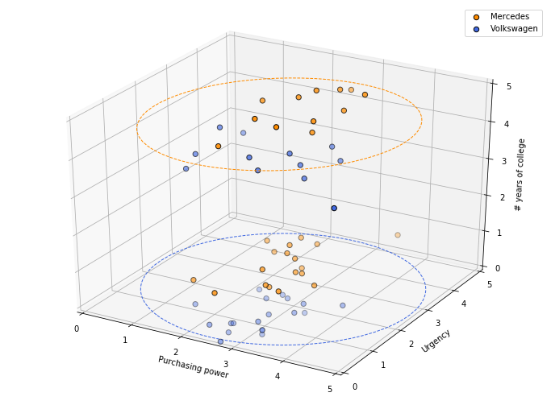
A Car Dealership Example (cont.)
Predict a customer’s choice
Add more data (feature) on “# years of college”
More Data isn’t Always Better
Despite the intuition most us have that more information can’t hurt, it actually can – Aaron Lipeles

Slide 13
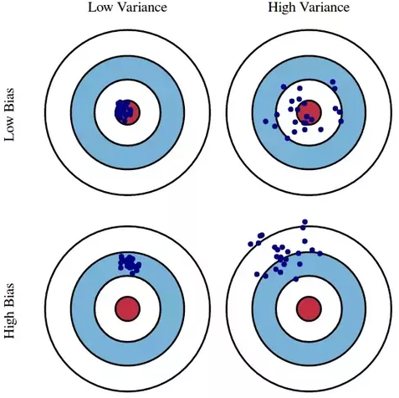
More Data Samples
High Variance Model
Model is sensitive to small fluctuations in the training set (overfitting)
Modeling random noise in the training data, rather than the intended outputs
Adding more data samples will help
High Bias Model
Model is too simple (underfitting)
Missing the relevant relations between features and target outputs
Adding more data samples will not help

Slide 14
Disadvantages of More Data
More data does not always help
In General
More Data -> Stronger Noise
More Data -> More Arbitrary Correlations
Spurious correlation can easily outnumber meaningful correlations
More Data -> Higher Dimensionality
Harder to converge
More Data -> More Local Minima
Easier to get stuck in local minima

Slide 15
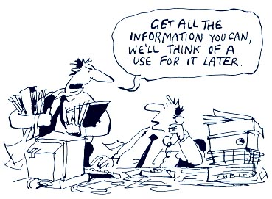
Better Data Instead
Better Data != More Data
Data Preprocessing
Removing outliers
Denoising
Filling out missing values
Feature Selection
Dimension Reduction
Smart Sampling
Importance Sampling
Stratified Sampling
Better Data sometimes means Less Data

Slide 16
Pitfall 3: Are AI models Reliable?
How reliable are the AI models?
Do we know when they succeed?
And when will they fail?
Can AI models be fooled?
If an AI model makes an error, can we correct the error?

Slide 17
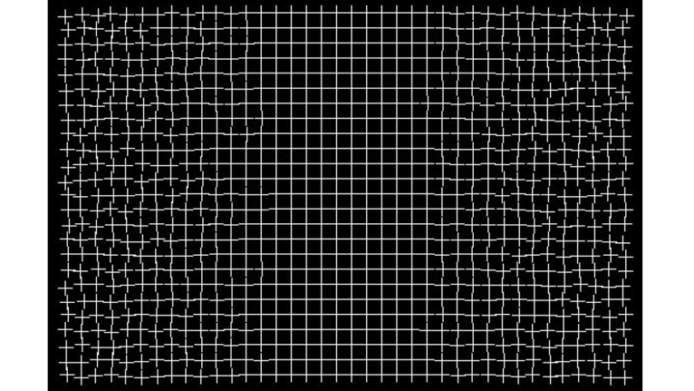
Optical Illusions: An Example
The Grid Fixes Itself
http://illusionoftheyear.com/2005/08/healing-grid/
Notes:
If you stare at the center of the grid, the crazy peripheries begin to fix themselves. It is thought that the brain has a bias towards order and regular patterns and will actually go about "fixing" the problems on the sides.

Slide 18
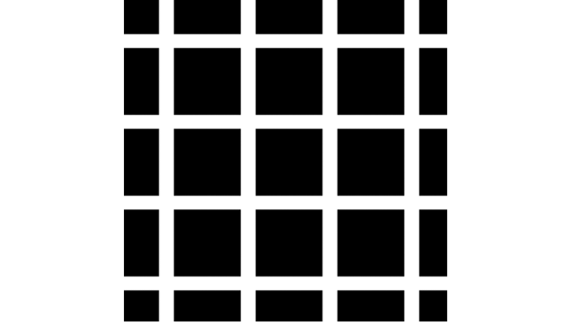
Optical Illusions
How many black dots can see you see?
If your brain can be fooled, so can neural networks.

Slide 19
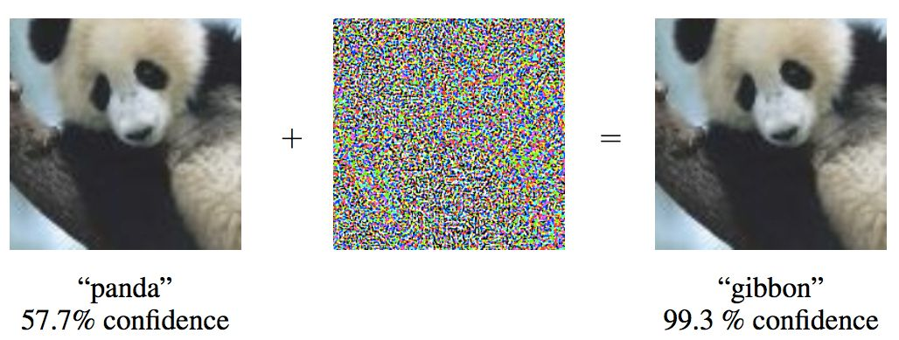
Adversarial Attacks
Adversarial Examples
Inputs to a neural network that result in an incorrect output from the network
Ian J. Goodfellow, Jonathon Shlens, Christian Szegedy, Explaining and Harnessing Adversarial Examples, arXiv:1412.6572, 2014.

Slide 20
Adversarial Attack Posts High Security Risks
Systems incorporating deep learning models have a very high-security risk
Unlock an iPhone X’s “Face ID”
Fooling surveillance cameras
Bypass biometric security systems
“Assassinate” a self-driving car by posting an adversarial stop sign at an intersection
Many others

Slide 21
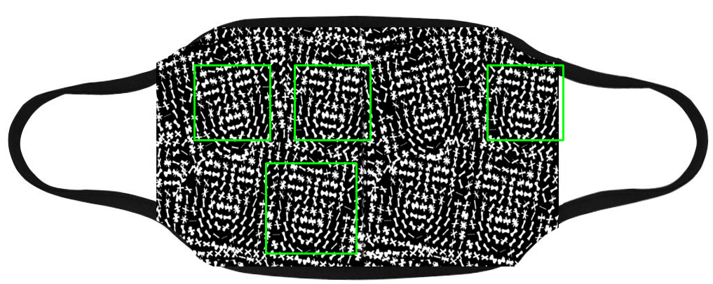
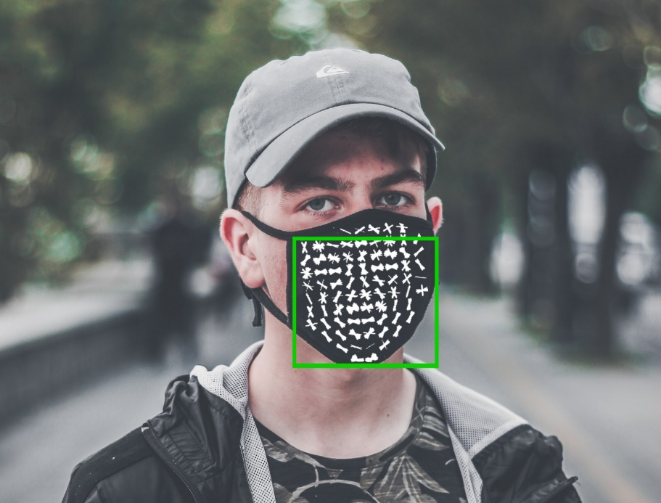
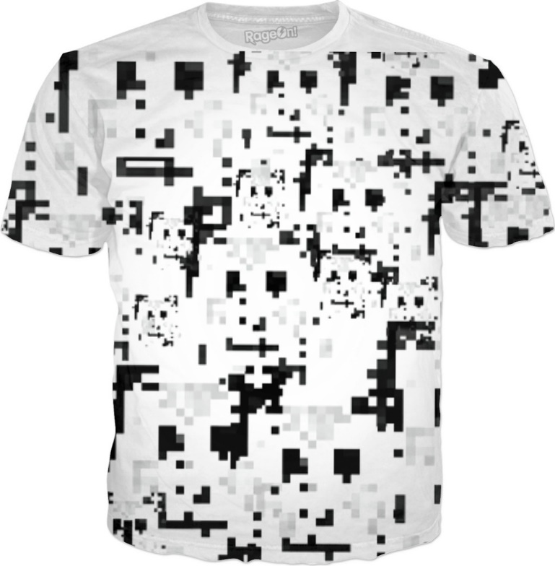
Fooling a Face Recognition System
Face masks, T-shirt, etc. can be used to fool a face recognition system.

Slide 22
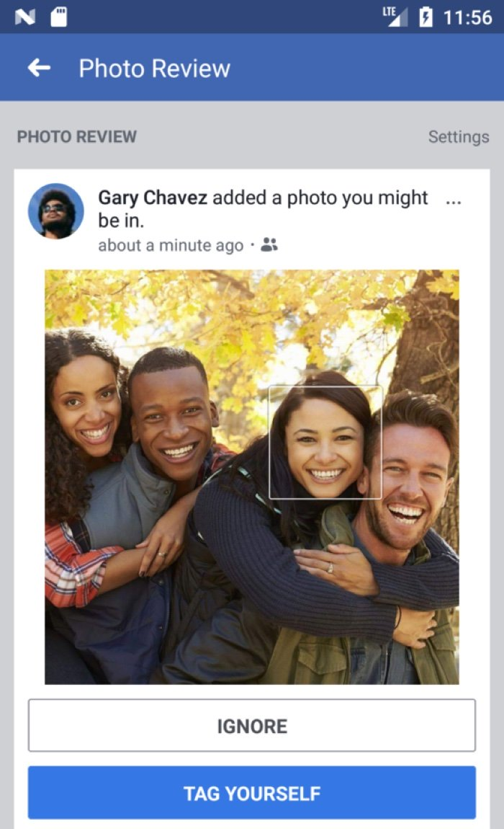
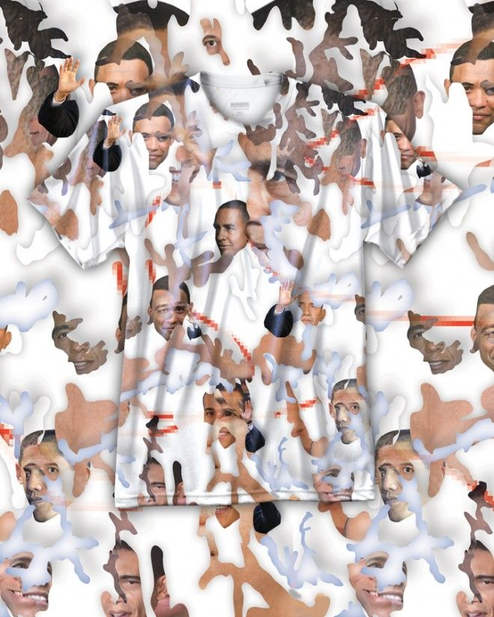
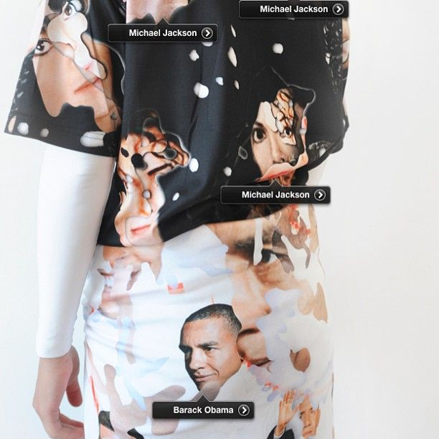
Confusing Facebook’s Auto-Tagging
T-shirts are designed to confuse Facebook’s auto-tagging function.

Slide 23
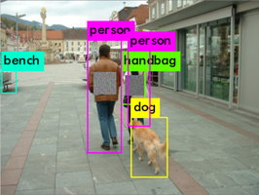
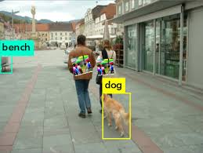
Fooling a Surveillance Camera
Adversarial patches can attack person detection system.
Simen Thys, Wiebe Van Ranst, Toon Goedemé, Fooling automated surveillance cameras: adversarial patches to attack person detection, arXiv:1904.08653, 2019.

Slide 24
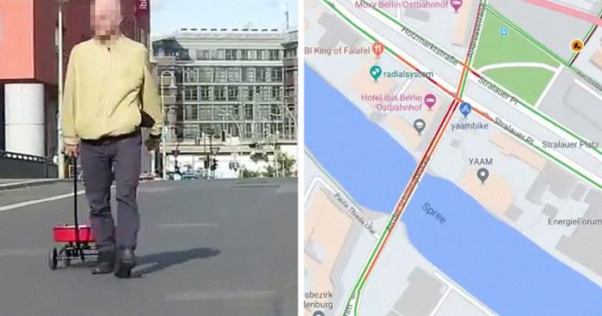
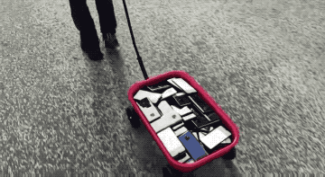
Simon Weckert’s Traffic Jam
Google Map Hacks
A little red wagon
Filled with 99 secondhand cellphones
Each running google map navigation
Turning a green street into red
Generate a virtual traffic jam

Slide 25
Classes of Adversarial Attacks
Targeted Example
A small amount of carefully constructed noise added to an image
Looking exactly the same to a human
Causing a neural network to misclassify
Non-targeted Example
Try to find any input that tricks the neural network
May look like noise to a human

Slide 26
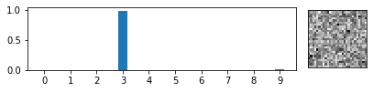
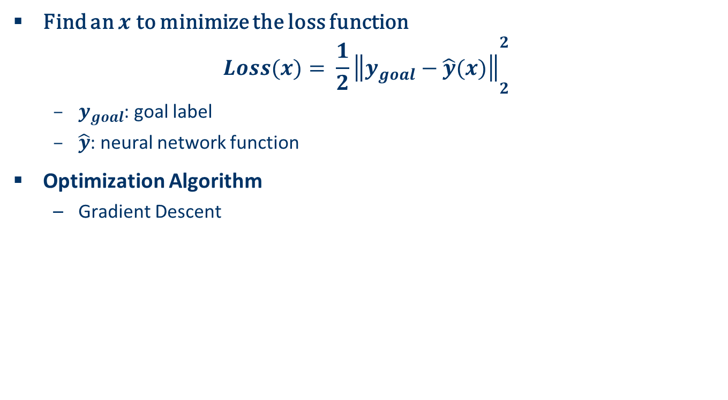
Non-Targeted Attack
Find an $x$ to minimize the loss function
$$Loss(x)= {\frac{1}{2}\left\|y_{goal}−\hat{y}(x)\right\|}_{2}^{2}$$
$y_{goal}$: goal label
$\hat{y}$: neural network function
Optimization Algorithm
Gradient Descent

Slide 27
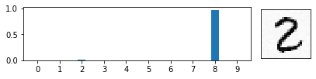
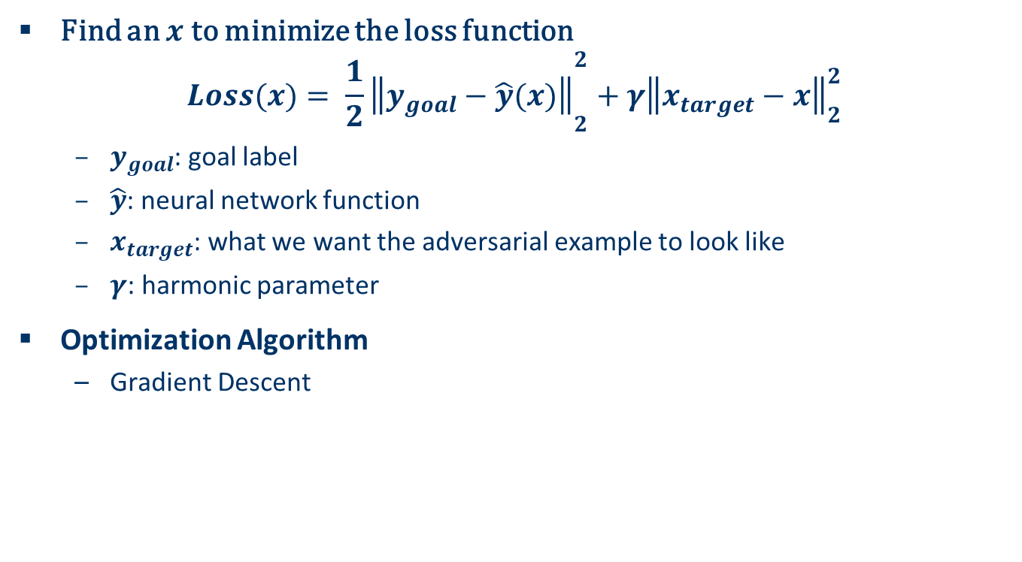
Targeted Attack
Find an $x$ to minimize the loss function
$$Loss(x)= {\frac{1}{2}\left\|y_{goal}−\hat{y}(x)\right\|}_{2}^{2}+{γ\left\|x_{target}−x\right\|}_{2}^{2}$$
$y_{goal}$: goal label
$\hat{y}$: neural network function
$x_{target}$: what we want the adversarial example to look like
$γ$: harmonic parameter
Optimization Algorithm
Gradient Descent

Slide 28
Demo: Adversarial Attacks on MNIST Recognition
Jupyter notebook adversarial_attack.ipynb

